Slide 1

“Your Project Name”
Task - 2

Slide 2
Job Search Website
CB2_3
LMS username | Name | Batch
Au612820104001 | Ajaykumar P | CB2_3
Au612820104002 | Ajith s | CB2_3
au612820104003 | Ajith kumar M | CB2_3
au612820104007 | Gnana vignesh K | CB2_3

Slide 3

Taskꢀ-ꢀ2
CreateꢀUIꢀandꢀimplementꢀvariousꢀcomponentsꢀusingꢀreact
●
●
●
SplitꢀdesignꢀintoꢀcomponentsꢀandꢀHigherꢀorderꢀComponents
Defineꢀstructureꢀofꢀtheꢀcomponents
Setꢀtheꢀbasicꢀuiꢀcomponentsꢀwithꢀdummyꢀdata
IntegrateꢀtheꢀAPIsꢀtoꢀfrontendꢀtoꢀensureꢀtheꢀdynamicꢀfeatureꢀofꢀwebsite
●
●
●
●
●
Pointꢀbaseꢀapiꢀtoꢀtheꢀseversꢀbaseꢀurlꢀ
Designꢀapiꢀcallsꢀforꢀeachꢀelementꢀ
Handleꢀerrorsꢀinꢀtheꢀoutput
Renderꢀoutputꢀofꢀapisꢀtoꢀdifferentꢀlowꢀlevelꢀcomponents
Secureꢀcontentꢀofꢀpostꢀapisx
EvaluationꢀMetric:
● 100%ꢀCompletionꢀofꢀtheꢀaboveꢀtasks
Learning Outcome
▪
▪
▪
▪
DevelopingꢀcomplicatedꢀUIꢀusingꢀreactꢀcomponents
Usingꢀpropsꢀdrillingꢀandꢀcontextꢀtoꢀpassꢀvariables
Gettingꢀfamiliarꢀwithꢀdifferentꢀtypeꢀofꢀapiꢀcalls
Handlingꢀdifferentꢀinputꢀdata

Slide 4
Description Retail food delivery is a courier service in which a restaurant, store, or independent food-delivery company delivers food to a customer. An order is typically made either through a restaurant or grocer's website or mobile app, or through a food ordering company. The delivered items can include entrees, sides, drinks, desserts, or grocery items and are typically delivered in boxes or bags. The delivery person will normally drive a car, but in bigger cities where homes and restaurants are closer together, they may use bikes or motorized scooters.

Slide 5
User Interface(UI) Clean and intuitive design to enhance user experience.A responsive layout that adapts to different screen sizes and devices, ensuring accessibility on both desktop and mobile platforms. Consistent and appealing color schemes, typography, and imagery

Slide 6
Search and Navigation Search bar for users to enter keywords, location, job category, and other filters.Filters and sorting options to refine search results, including job type (full-time, part-time, contract), location, salary range, and date posted.Easy-to-navigate menus, categories, and subcategories for job listings. Job Listings Display of job listings with key information such as job title, company, location, date posted, and a brief description.Thumbnail images or logos for job listings (if available).Pagination or infinite scrolling for easy browsing through multiple listings.

Slide 7
Description Retail food delivery is a courier service in which a restaurant, store, or independent food-delivery company delivers food to a customer. An order is typically made either through a restaurant or grocer's website or mobile app, or through a food ordering company. The delivered items can include entrees, sides, drinks, desserts, or grocery items and are typically delivered in boxes or bags. The delivery person will normally drive a car, but in bigger cities where homes and restaurants are closer together, they may use bikes or motorized scooters.

Slide 8
User Accounts Satisfying the customers’ rapid needs is a complex task, which is why food delivery apps emerged.Equally, keeping customers engaged with your app is a daunting task; thus, comprehensive UI/UX keeps your customers engaged with your app significantly.There are a few roles that UI/UX design plays in keeping your online food delivery business running and during food app development:

Slide 9
Security: Secure user data storage and transmission. Protection against common web security threats, such as SQL injection and cross-site scripting. Frontend developers for job search websites use technologies like HTML, CSS, JavaScript, and various frontend frameworks and libraries to create a visually appealing and user-friendly experience that meets the needs of both a food ordering company. They must also ensure the website's compatibility with various web browsers and devices.

Slide 10

AssessmentꢀParameter
SetupꢀProjectꢀforꢀCalculatorꢀ
project
Setupꢀbasicꢀstructureꢀofꢀtext-
editorꢀproject
Createꢀaꢀmainꢀcomponentꢀwithꢀtheꢀ
outerꢀstructureꢀofꢀcalculator
Check-List
Createꢀmainꢀcomponentꢀwithꢀ
allꢀfeatureꢀbuttons
Createꢀaꢀbuttonꢀcomponentꢀ
withꢀonꢀclickꢀhandler
Createꢀaꢀjsonꢀobjectꢀtoꢀstoreꢀ
dataꢀforꢀtextꢀeditor
Createꢀaꢀ`ꢀevaluateExpresion`ꢀ
functionꢀtoꢀevaluateꢀvalue
Pushꢀbothꢀcodeꢀtoꢀgithub

Slide 11
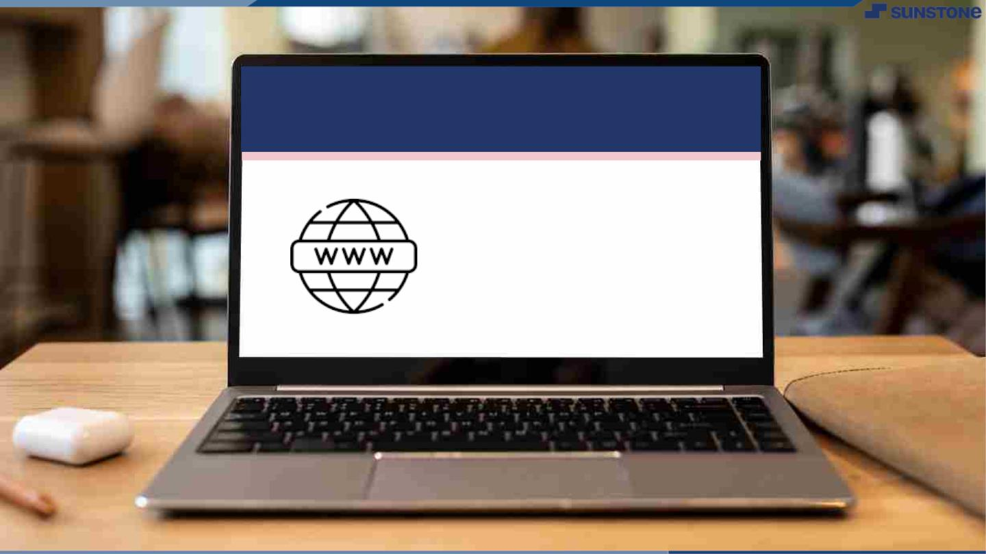
Submission Github
https://github.com/Ajaykumar6128
https://github.com/Ajith498
https://github.com/ajithkumar175
https://github.com/GnanaVigneshcse

Slide 12


